Slide 1

Submodular maximization
Leah London Arazi & Sapir Ben David

Slide 2
outline
Submodular Maximization Problem
Greedy Sequential Algorithm
RandGreeDI MPC Algorithm
Threshold Greedy Sequential Algorithm
Sample-and-Prune Technique
Threshold MPC Algorithm

Slide 3
Submodular maximization problem

Slide 4
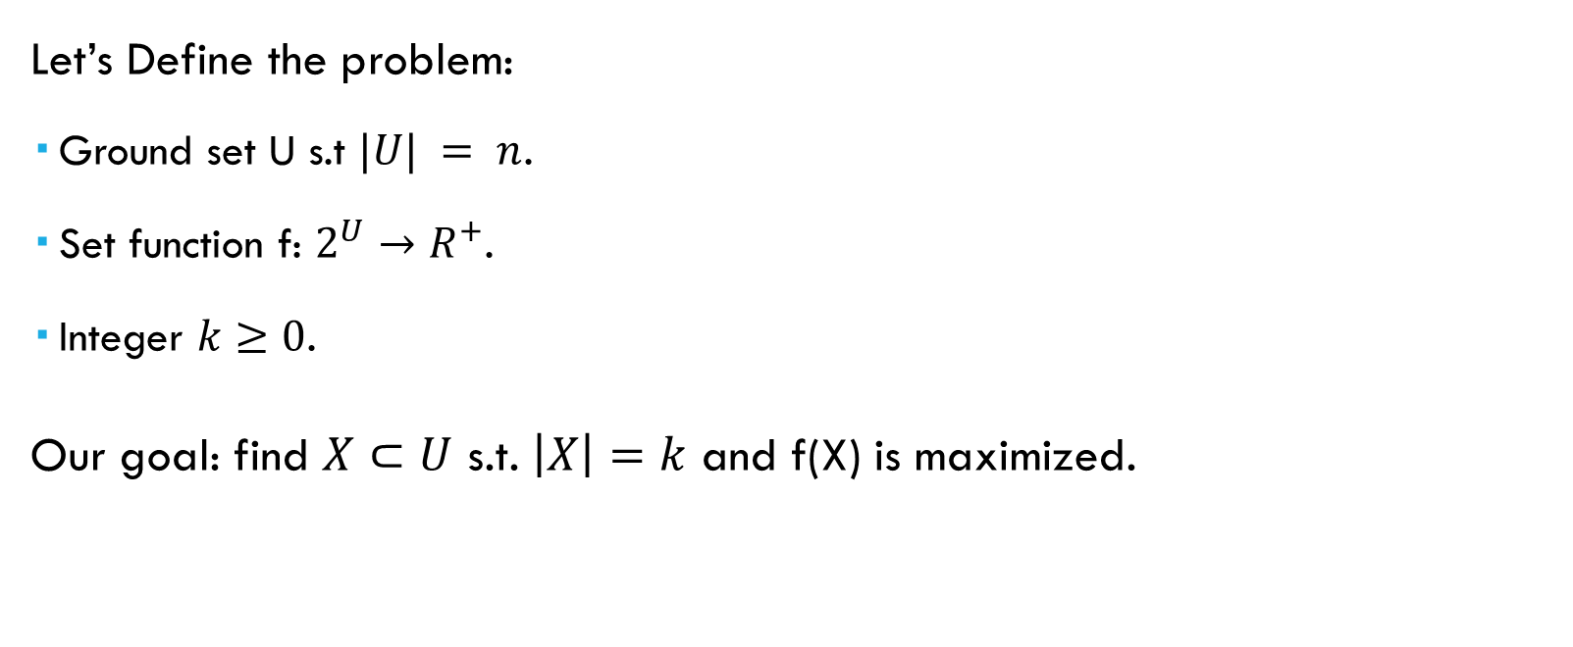
introduction
Let’s Define the problem:
Ground set U s.t $|U| = n$.
Set function f: $2^{U}→R^{+}$.
Integer $k≥0$.
Our goal: find $X⊂U$ s.t. $\left|X\right|=k$ and f(X) is maximized.
Notes:
Maximize monotone submodular functions under cardinality constraints.
הפונקציה מחזירה מחיר לכל קבוצה

Slide 5
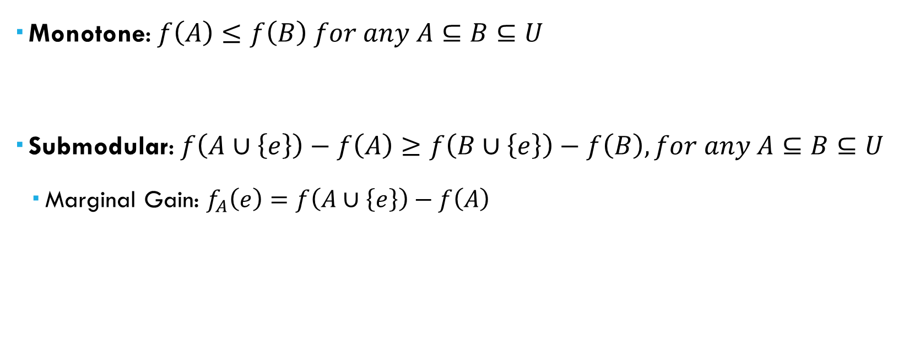
Properties of the set function f
Monotone: $f\left(A\right)≤f\left(B\right) for any A⊆B⊆U$
Submodular: $f\left(A∪\left\{e\right\}\right)−f\left(A\right)≥f\left(B∪\left\{e\right\}\right)−f\left(B\right), for any A⊆B⊆U$
Marginal Gain: $f_{A}\left(e\right)=f\left(A∪\left\{e\right\}\right)−f\left(A\right)$
Notes:
Adding an element to a small set A will increase the marginal gain more than adding it to the superset of A.
להוסיף איבר עכשיו יתרום לנו יותר מאשר להוסיף אותו אחר כך

Slide 6
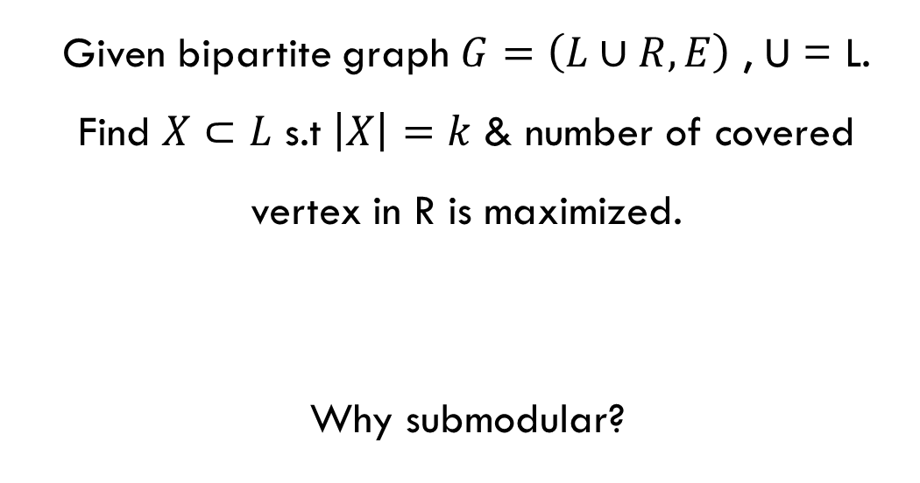

Example: k-coverage problem
L
R
1
a
Given bipartite graph $G=\left(L∪R,E\right)$ , U = L. Find $X⊂L$ s.t $\left|X\right|=k$ & number of covered vertex in R is maximized.
Why submodular?
2
b
3
c
4
d
5
e
$$\text{Submodular}: f_{A}\left(e\right)≥f_{B}\left(e\right), A⊂B⊂U$$
$$f_{A}\left(e\right)=f\left(A∪\left\{e\right\}\right)−f\left(A\right)$$
Notes:
יש הרבה בעיות כאלו ואנחנו נראה דוגמא לבעיה כזו
להסביר מה הפונקציה עושה

Slide 7
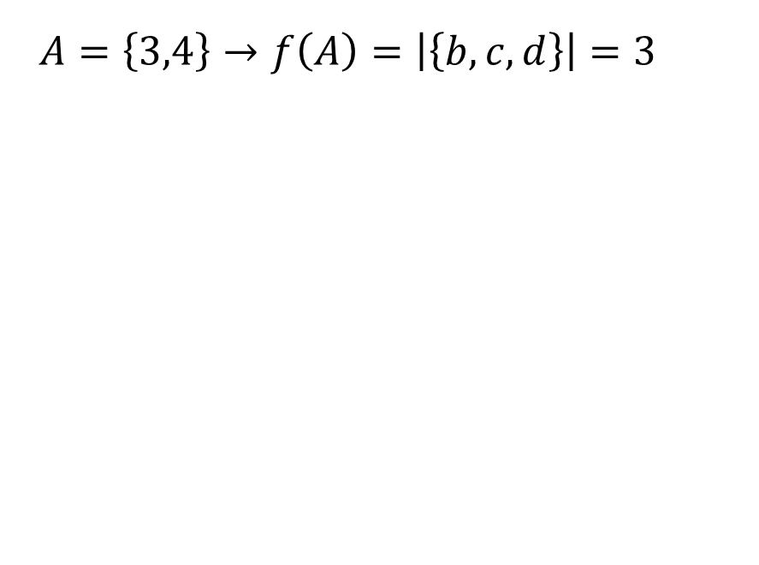
Example: k-coverage problem
L
R
$A=\left\{3,4\right\}→f\left(A\right)=\left|\left\{b,c,d\right\}\right|=3$
1
a
2
b
3
c
A
4
d
5
e
$$\text{Submodular}: f_{A}\left(e\right)≥f_{B}\left(e\right), A⊂B⊂U$$
$$f_{A}\left(e\right)=f\left(A∪\left\{e\right\}\right)−f\left(A\right)$$

Slide 8
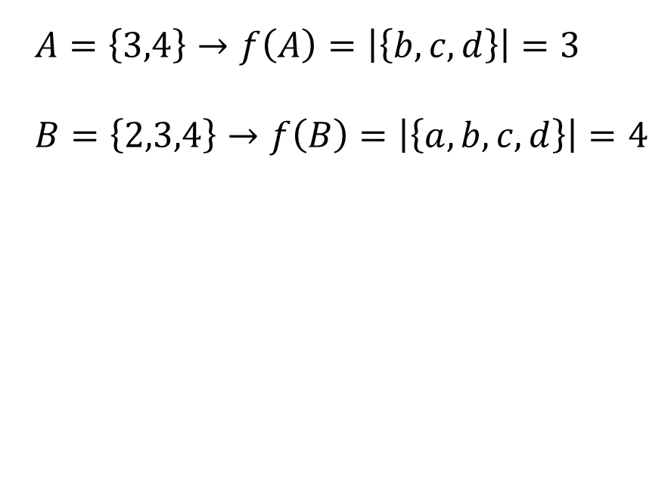
Example: k-coverage problem
L
R
$A=\left\{3,4\right\}→f\left(A\right)=\left|\left\{b,c,d\right\}\right|=3$
$B=\left\{2,3,4\right\}→f\left(B\right)=\left|\left\{a,b,c,d\right\}\right|=4$
1
a
2
b
B
3
c
A
4
d
5
e
$$\text{Submodular}: f_{A}\left(e\right)≥f_{B}\left(e\right), A⊂B⊂U$$
$$f_{A}\left(e\right)=f\left(A∪\left\{e\right\}\right)−f\left(A\right)$$

Slide 9
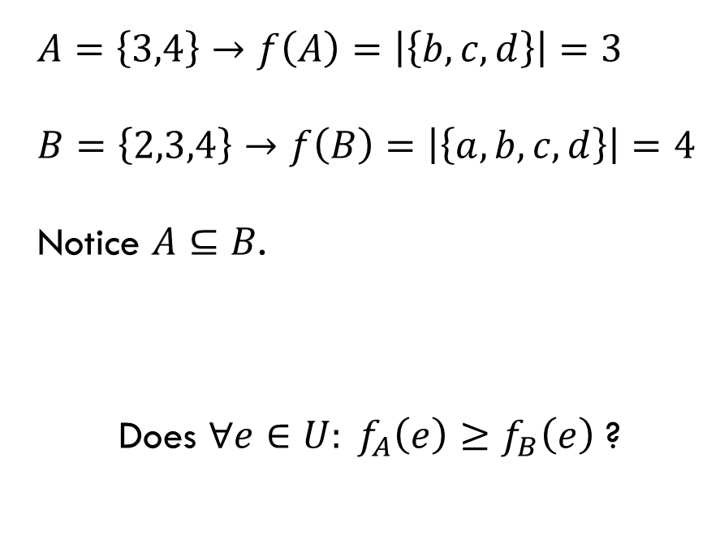
Example: k-coverage problem
L
R
$A=\left\{3,4\right\}→f\left(A\right)=\left|\left\{b,c,d\right\}\right|=3$
$B=\left\{2,3,4\right\}→f\left(B\right)=\left|\left\{a,b,c,d\right\}\right|=4$
Notice $A⊆B$.
Does $∀e∈U: f_{A}\left(e\right)≥f_{B}\left(e\right)$ ?
1
a
2
b
B
3
c
A
4
d
5
e
$$\text{Submodular}: f_{A}\left(e\right)≥f_{B}\left(e\right), A⊂B⊂U$$
$$f_{A}\left(e\right)=f\left(A∪\left\{e\right\}\right)−f\left(A\right)$$

Slide 10
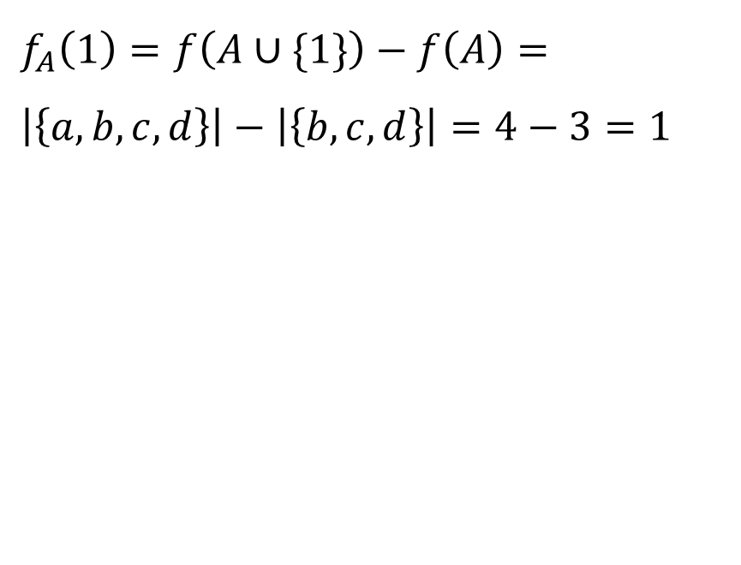
Example: k-coverage problem
L
R
$f_{A}\left(1\right)=f\left(A∪\{1\}\right)−f\left(A\right)=\left|\left\{a,b,c,d\right\}\right|−\left|\left\{b,c,d\right\}\right|=4−3=1$
1
a
2
b
B
3
c
A
4
d
5
e
$$\text{Submodular}: f_{A}\left(e\right)≥f_{B}\left(e\right), A⊂B⊂U$$
$$f_{A}\left(e\right)=f\left(A∪\left\{e\right\}\right)−f\left(A\right)$$

Slide 11
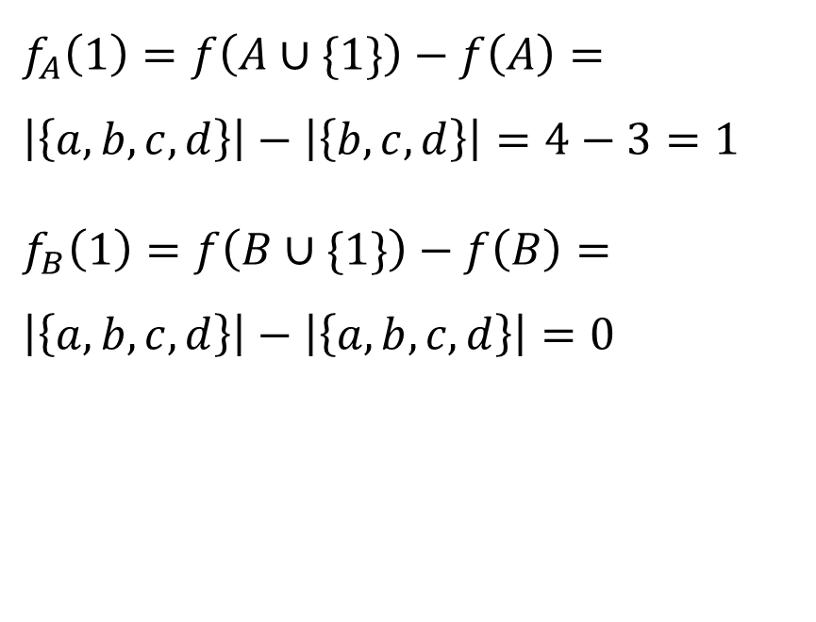
Example: k-coverage problem
L
R
$f_{A}\left(1\right)=f\left(A∪\{1\}\right)−f\left(A\right)=\left|\left\{a,b,c,d\right\}\right|−\left|\left\{b,c,d\right\}\right|=4−3=1$
$f_{B}\left(1\right)=f\left(B∪\{1\}\right)−f\left(B\right)=\left|\left\{a,b,c,d\right\}\right|−\left|\left\{a,b,c,d\right\}\right|=0$
1
a
2
b
B
3
c
A
4
d
5
e
$$\text{Submodular}: f_{A}\left(e\right)≥f_{B}\left(e\right), A⊂B⊂U$$
$$f_{A}\left(e\right)=f\left(A∪\left\{e\right\}\right)−f\left(A\right)$$

Slide 12
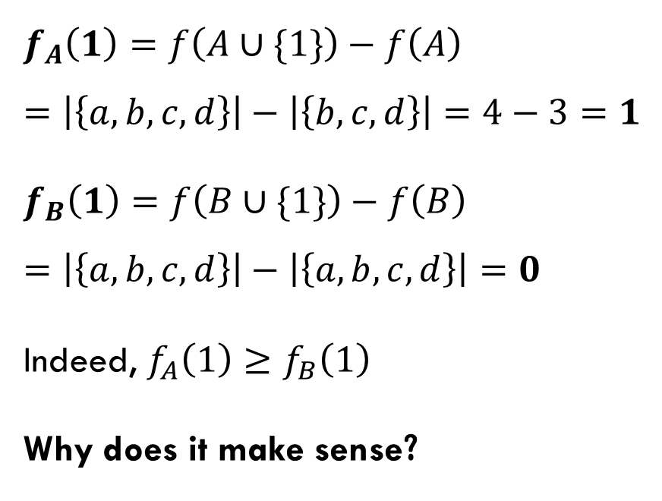
Example: k-coverage problem
L
R
$f_{A}\left(1\right)=f\left(A∪\{1\}\right)−f\left(A\right)=\left|\left\{a,b,c,d\right\}\right|−\left|\left\{b,c,d\right\}\right|=4−3=1$
$f_{B}\left(1\right)=f\left(B∪\{1\}\right)−f\left(B\right)=\left|\left\{a,b,c,d\right\}\right|−\left|\left\{a,b,c,d\right\}\right|=0$
Indeed, $f_{A}\left(1\right)≥f_{B}\left(1\right)$
Why does it make sense?
1
a
2
b
B
3
c
A
4
d
5
e
$$\text{Submodular}: f_{A}\left(e\right)≥f_{B}\left(e\right), A⊂B⊂U$$
$$f_{A}\left(e\right)=f\left(A∪\left\{e\right\}\right)−f\left(A\right)$$
Notes:
לוודא שהבינו את האינטואיציה של התכונה תת מודולריות
להגיד בעל פה : הגיוני שאם נוסיף צומת לקבוצה קטנה נגדיל את הכיסוי של אר מאשר שנוסיף את הצומת הזו לקבוצה גדולה יותר

Slide 13
Now, how do you solve this problem?
Unfortunately, submodular maximization is NP-hard.
Finding the exact X isn’t easy.
So, we will see approximation algorithms

Slide 14
greedy sequential algorithm
Notes:
נתחיל עם אלגוריתם סידרתי שרץ על מכונה אחת ומוסיף בגרידיות איברים שתורמים הכי הרבה באותה נקודת זמן

Slide 15
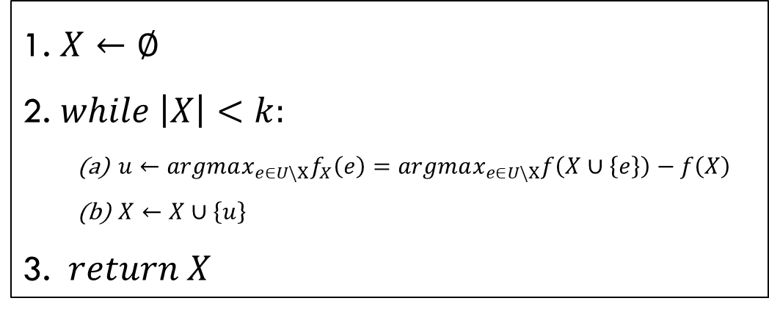
greedy sequential algorithm
Greedy greedily adds one by one the element with the largest marginal gain w.r.t. the current set.
1. $X←∅$
2. $while \left|X\right|<k:$
$u←argmax_{e∈U\backslash X}f_{X}\left(e\right)=argmax_{e∈U\backslash X}f\left(X∪\left\{e\right\}\right)−f\left(X\right)$
$X←X∪\left\{u\right\}$
3. $return X$
Notes:
סידרתי אומר שמורץ על מכונה אחת.

Slide 16
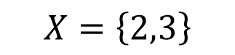
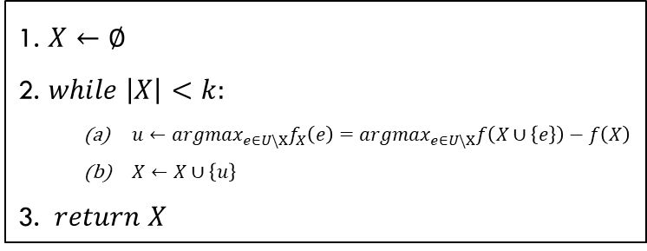
Example- 2-coverage problem
1. $X←∅$
2. $while \left|X\right|<k:$
$u←argmax_{e∈U\backslash X}f_{X}\left(e\right)=argmax_{e∈U\backslash X}f\left(X∪\left\{e\right\}\right)−f\left(X\right)$
$X←X∪\left\{u\right\}$
3. $return X$
L
R
1
a
2
b
3
c
$$X=\left\{2,3\right\}$$
4
d
5
e
It seems that Greedy found X which maximizes the coverage on R.
So why did I say approximation algorithms?
Notes:
זה נראה שגרידי אכן מצא תת הקבוצה של אל, איקס בגודל 2 שממקסמת את מספר האיברים שמכוסים באר.
אז למה גרידי רק מקרב את הפתרון?

Slide 17
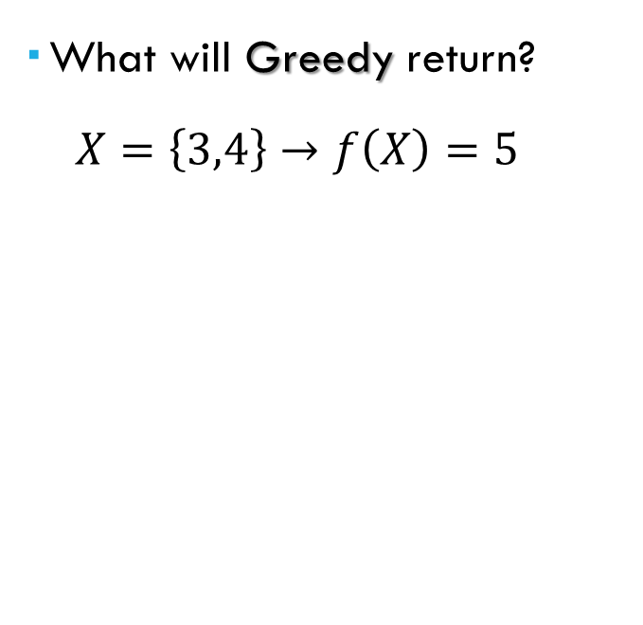
Why approximation?
1. $X←∅$
2. $while \left|X\right|<k:$
$u←argmax_{e∈U\backslash X}f_{X}\left(e\right)=argmax_{e∈U\backslash X}f\left(X∪\left\{e\right\}\right)−f\left(X\right)$
$X←X∪\left\{u\right\}$
3. $return X$
L
R
What will Greedy return?
$$X=\left\{3,4\right\}→f\left(X\right)=5$$
1
a
2
b
3
c
4
d
5
e
f
Notes:
זה נראה שגרידי אכן מצא תת הקבוצה של אל, איקס בגודל 2 שממקסמת את מספר האיברים שמכוסים באר.
אז למה גרידי רק מקרב את הפתרון?

Slide 18
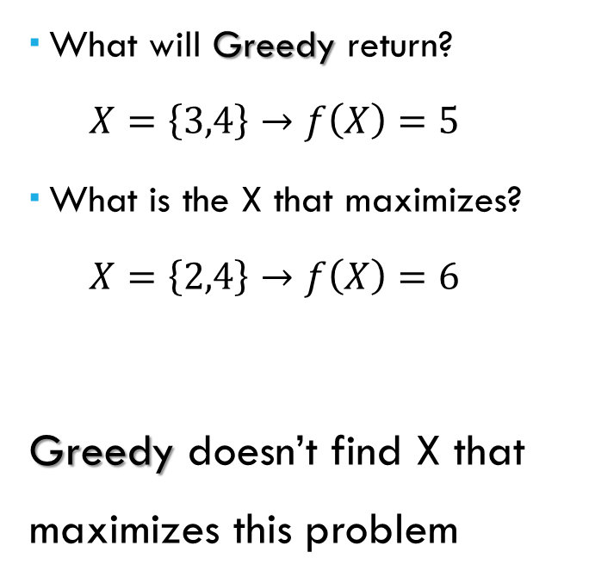
Why approximation?
1. $X←∅$
2. $while \left|X\right|<k:$
$u←argmax_{e∈U\backslash X}f_{X}\left(e\right)=argmax_{e∈U\backslash X}f\left(X∪\left\{e\right\}\right)−f\left(X\right)$
$X←X∪\left\{u\right\}$
3. $return X$
L
R
What will Greedy return?
$$X=\left\{3,4\right\}→f\left(X\right)=5$$
What is the X that maximizes?
$$X=\left\{2,4\right\}→f\left(X\right)=6$$
Greedy doesn’t find X that maximizes this problem
1
a
2
b
3
c
4
d
5
e
f
Notes:
זה נראה שגרידי אכן מצא תת הקבוצה של אל, איקס בגודל 2 שממקסמת את מספר האיברים שמכוסים באר.
אז למה גרידי רק מקרב את הפתרון?

Slide 19

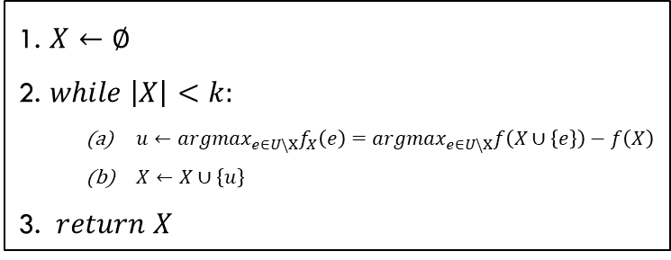
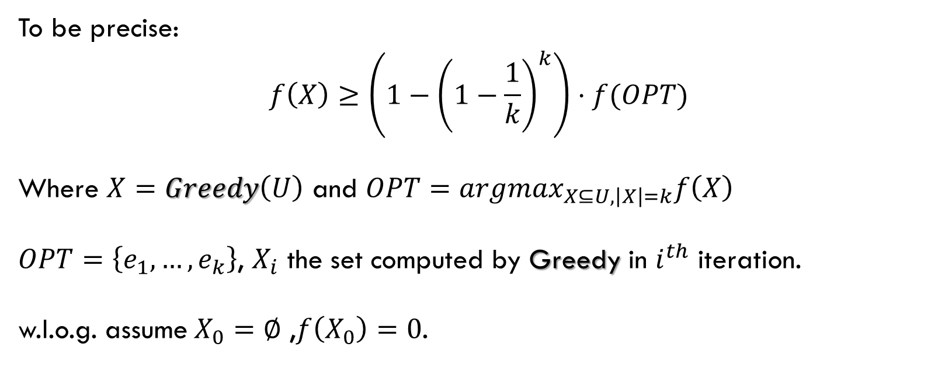
Greedy is a $\left(1−\frac{1}{e}\right)$ approximation algo’
To be precise:
$$f\left(X\right)≥\left(1−{\left(1−\frac{1}{k}\right)}^{k}\right)⋅f(OPT)$$
Where $X=Greedy\left(U\right)$ and $OPT=argmax_{X⊆U,\left|X\right|=k}f\left(X\right)$
$OPT=\left\{e_{1},…,e_{k}\right\}$, $X_{i}$ the set computed by Greedy in $i^{th}$ iteration.
w.l.o.g. assume$X_{0}=∅$ ,$f\left(X_{0}\right)=0$.
1. $X←∅$
2. $while \left|X\right|<k:$
$u←argmax_{e∈U\backslash X}f_{X}\left(e\right)=argmax_{e∈U\backslash X}f\left(X∪\left\{e\right\}\right)−f\left(X\right)$
$X←X∪\left\{u\right\}$
3. $return X$
Notes:
אם הפונקציה על קבוצה ריקה הייתה מחזיר קבוע כלשהו, בהוכחה ניתן לרארות שזה היה רק משפר את הקירוב.
ולכן נוכל בה"כ להניח שהפונקציה על הקבוצה הריקה מחזירה 0, הערך המינימלי שאפשר להחזיר.

Slide 20

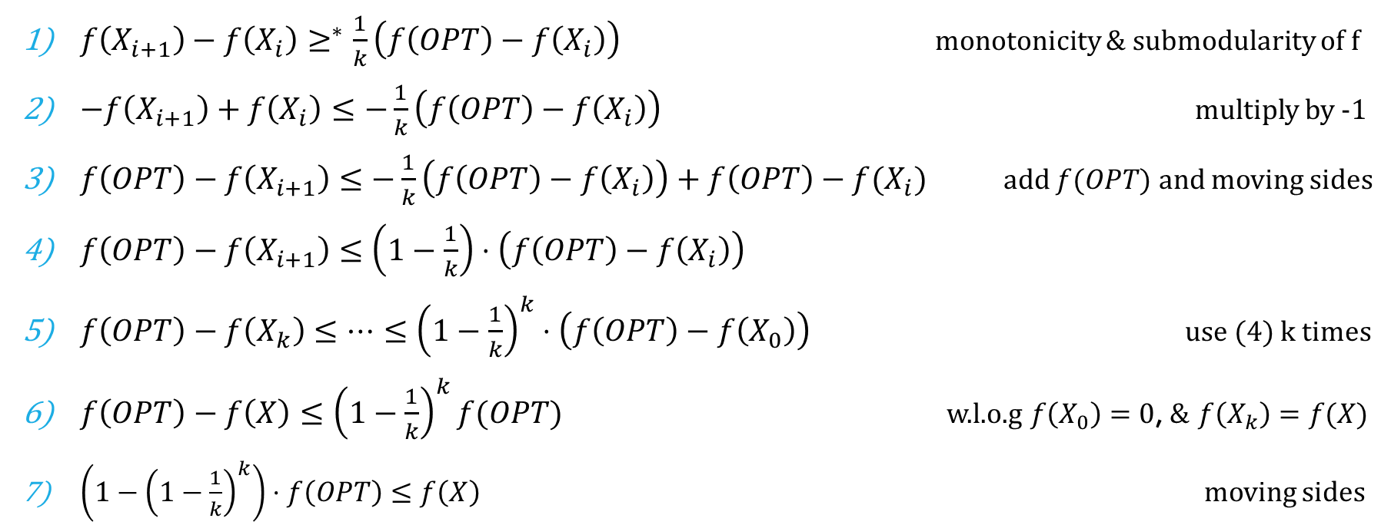
Prove $\left(1−\frac{1}{e}\right)⋅f\left(OPT\right)≤f\left(X\right)$
1. $X←∅$
2. $while \left|X\right|<k:$
$u←argmax_{e∈U\backslash X}f_{X}\left(e\right)=argmax_{e∈U\backslash X}f\left(X∪\left\{e\right\}\right)−f\left(X\right)$
$X←X∪\left\{u\right\}$
3. $return X$
$f\left(X_{i+1}\right)−f\left(X_{i}\right)≥^{∗}\frac{1}{k}\left(f\left(OPT\right)−f\left(X_{i}\right)\right)$ monotonicity & submodularity of f
$−f\left(X_{i+1}\right)+f\left(X_{i}\right)≤−\frac{1}{k}\left(f\left(OPT\right)−f\left(X_{i}\right)\right)$ multiply by -1
$f\left(OPT\right)−f\left(X_{i+1}\right)≤−\frac{1}{k}\left(f\left(OPT\right)−f\left(X_{i}\right)\right)+f\left(OPT\right)−f(X_{i})$ add $f(OPT)$ and moving sides
$f\left(OPT\right)−f\left(X_{i+1}\right)≤\left(1−\frac{1}{k}\right)⋅\left(f\left(OPT\right)−f\left(X_{i}\right)\right)$
$f\left(OPT\right)−f\left(X_{k}\right)≤…≤{\left(1−\frac{1}{k}\right)}^{k}⋅\left(f\left(OPT\right)−f\left(X_{0}\right)\right)$ use (4) k times
$f\left(OPT\right)−f\left(X\right)≤{\left(1−\frac{1}{k}\right)}^{k}f(OPT)$ w.l.o.g $f\left(X_{0}\right)=0$, & $f\left(X_{k}\right)=f(X)$
$\left(1−{\left(1−\frac{1}{k}\right)}^{k}\right)⋅f\left(OPT\right)≤f\left(X\right)$ moving sides
Notes:
בעצם מספיק להראות שכל איטרציה מקטינים את המרחק פי 1 חלקי קיי לפיתרון האופטימלי

Slide 21

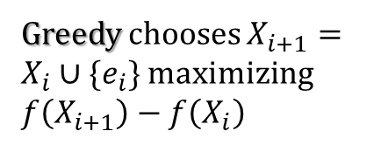
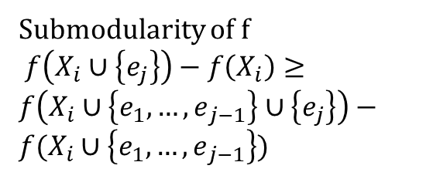
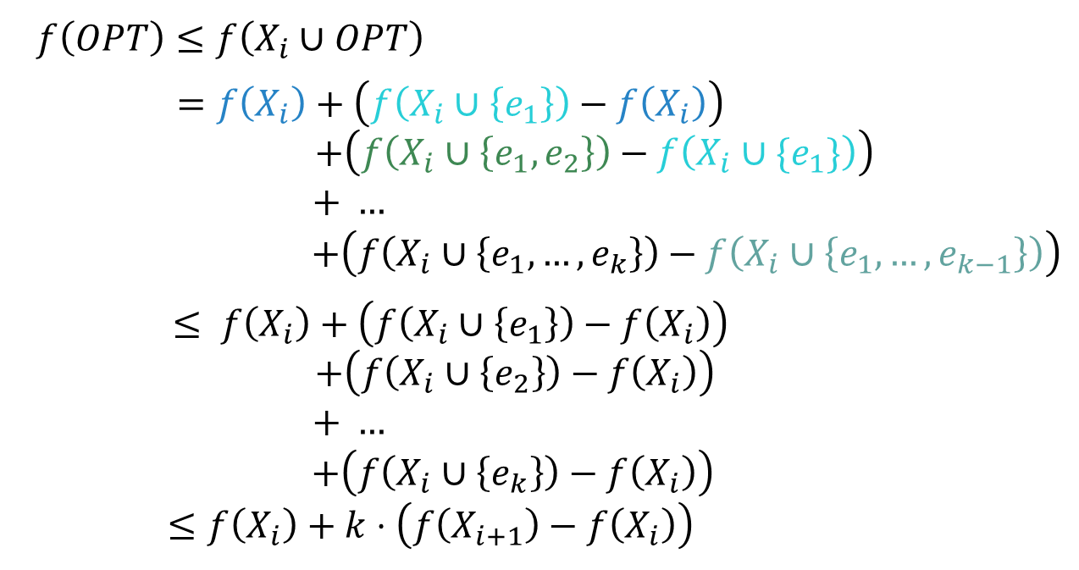
Prove $f\left(X_{i+1}\right)−f\left(X_{i}\right)≥\frac{1}{k}\left(f\left(OPT\right)−f\left(X_{i}\right)\right)$
1. $X←∅$
2. $while \left|X\right|<k:$
$u←argmax_{e∈U\backslash X}f_{X}\left(e\right)=argmax_{e∈U\backslash X}f\left(X∪\left\{e\right\}\right)−f\left(X\right)$
$X←X∪\left\{u\right\}$
3. $return X$
$f\left(OPT\right)≤f\left(X_{i}∪OPT\right)$
$=f\left(X_{i}\right)+\left(f\left(X_{i}∪\left\{e_{1}\right\}\right)−f\left(X_{i}\right)\right)$
$+\left(f\left(X_{i}∪\left\{e_{1}, e_{2}\right\}\right)−f\left(X_{i}∪\{e_{1}\}\right)\right)$
$+ …$
$+\left(f\left(X_{i}∪\left\{e_{1},…,e_{k}\right\}\right)−f\left(X_{i}∪\left\{e_{1},…,e_{k−1}\right\}\right)\right)$
$≤ f\left(X_{i}\right)+\left(f\left(X_{i}∪\left\{e_{1}\right\}\right)−f\left(X_{i}\right)\right)$
$+\left(f\left(X_{i}∪\left\{e_{2}\right\}\right)−f\left(X_{i}\right)\right)$
$+ …$
$+\left(f\left(X_{i}∪\left\{e_{k}\right\}\right)−f\left(X_{i}\right)\right)$
$≤f\left(X_{i}\right)+k⋅\left(f\left(X_{i+1}\right)−f\left(X_{i}\right)\right)$
Monotonicity of f
Telescoping sum
Submodularity of f
$f\left(X_{i}∪\left\{e_{j}\right\}\right)−f\left(X_{i}\right)≥$
$f\left(X_{i}∪\left\{{e_{1},…,e}_{j−1}\right\}∪\left\{e_{j}\right\}\right)−f(X_{i}∪\left\{{e_{1},…,e}_{j−1}\right\}$)
Greedy chooses $X_{i+1}=X_{i}∪\{e_{i}\}$ maximizing $f\left(X_{i+1}\right)−f\left(X_{i}\right)$
Notes:
לא להציג- מי שרוצה מוזמן לראות אחרי ההרצאה

Slide 22
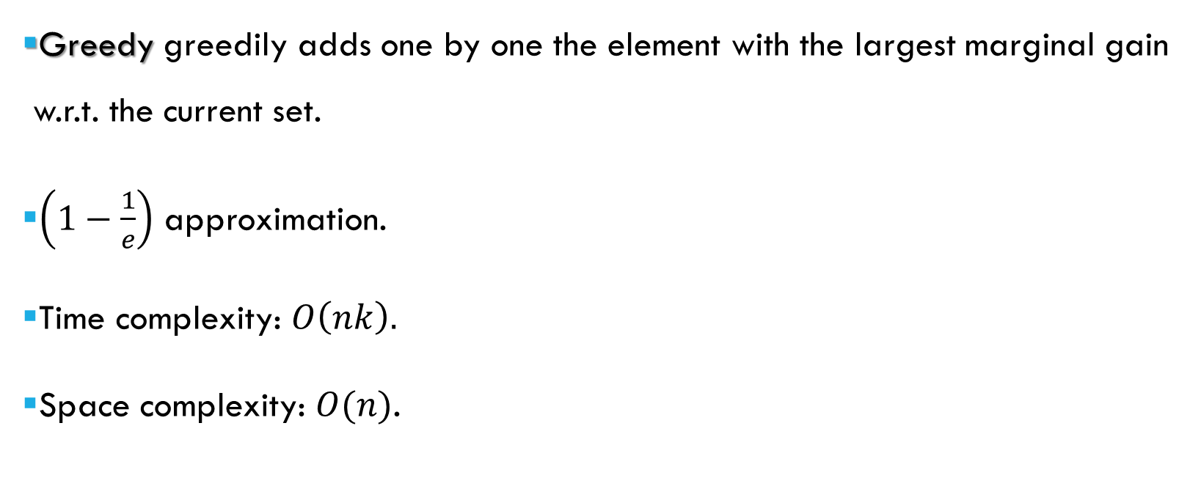
greedy sequential algorithm
1. $X←∅$
2. $while \left|X\right|<k:$
$u←argmax_{e∈U\backslash X}f_{X}\left(e\right)=argmax_{e∈U\backslash X}f\left(X∪\left\{e\right\}\right)−f\left(X\right)$
$X←X∪\left\{u\right\}$
3. $return X$
Greedy greedily adds one by one the element with the largest marginal gain w.r.t. the current set.
$\left(1−\frac{1}{e}\right)$ approximation.
Time complexity: $O\left(nk\right).$
Space complexity: $O(n)$.

Slide 23
RandGreeDI MPC Algorithm

Slide 24
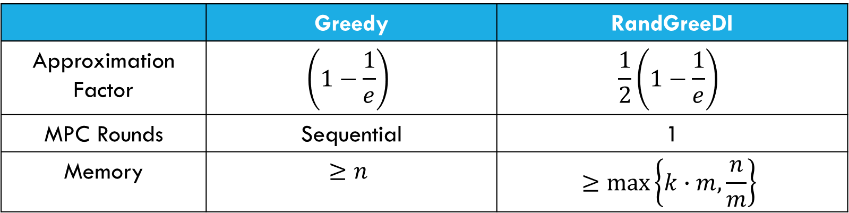
motivation
 | Greedy | RandGreeDI
Approximation Factor | $$\left(1−\frac{1}{e}\right)$$ | $$\frac{1}{2}\left(1−\frac{1}{e}\right)$$
MPC Rounds | Sequential | 1
Memory | $$≥n$$ | $$≥\max\left\{k∙m,\frac{n}{m}\right\}$$
We are giving up approximation to use less memory on each machine!

Slide 25
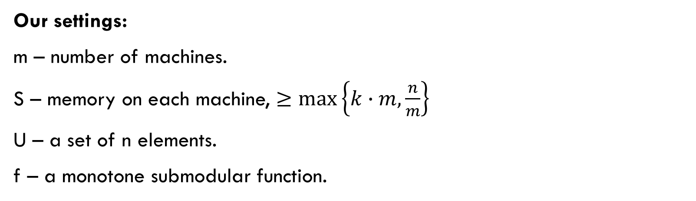
Randgreedi
Our settings:
m – number of machines.
S – memory on each machine, $≥\max\left\{k∙m,\frac{n}{m}\right\}$
U – a set of n elements.
f – a monotone submodular function.
Goal: find a subgroup X of size k that maximizes f.

Slide 26
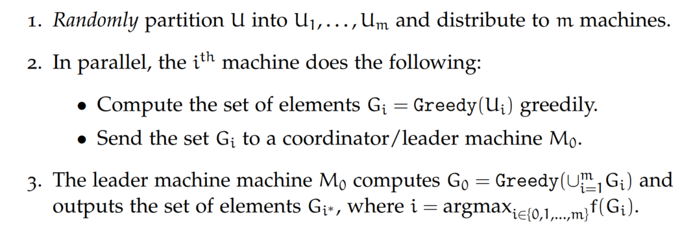
Randgreedi
U

Slide 27
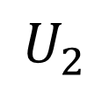
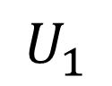
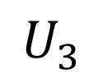
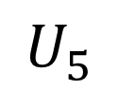
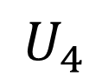
Randgreedi
U
D(m)
$$U_{1}$$
$$U_{2}$$
$$U_{3}$$
$$U_{4}$$
$$U_{5}$$

Slide 28
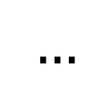
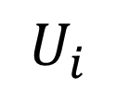
Randgreedi
GREEDY(
$$…$$
)
$$U_{i}$$

Slide 29
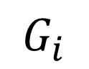
Randgreedi
GREEDY(
$$…$$
)
$$U_{i}$$
$$G_{i}$$

Slide 30
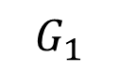
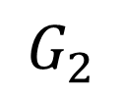
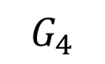
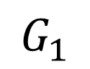
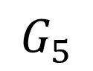
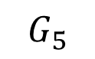
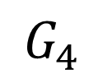
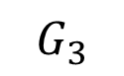
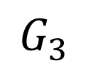
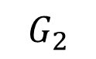
Randgreedi
$$G_{1}$$
$$G_{2}$$
$$G_{3}$$
$$G_{4}$$
$$G_{5}$$
$$G_{1}$$
$$G_{5}$$
Coordinator/Leader
$$M_{0}$$
$$G_{3}$$
$$G_{2}$$
$$G_{4}$$

Slide 31
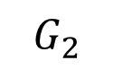
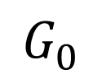
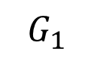
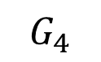
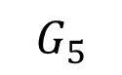
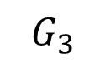
Randgreedi
$$G_{1}$$
$$G_{5}$$
GREEDY(
)
$$G_{3}$$
$$G_{2}$$
$$G_{4}$$
$$G_{0}$$

Slide 32
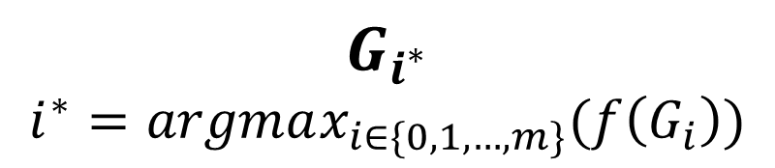
Randgreedi
$$G_{1}$$
$$G_{5}$$
GREEDY(
)
$$G_{3}$$
$$G_{2}$$
$$G_{4}$$
$$G_{i^{∗}}$$
$$i^{∗}=argmax_{i∈\{0,1,…,m\}}(f\left(G_{i}\right))$$
$$G_{0}$$
Notes:
Explain why $S≥\max\left\{k∙m,\frac{n}{m}\right\}$

Slide 33
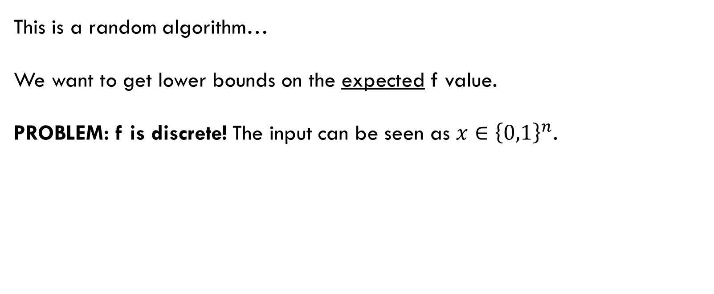
analysis
This is a random algorithm…
We want to get lower bounds on the expected f value.
PROBLEM: f is discrete! The input can be seen as $x∈{\left\{0,1\right\}}^{n}$.
The Lova´sz extension

Slide 34


The Lova´sz extension
Continuous selection vector $x∈{\left[0,1\right]}^{n},x=(x_{1},x_{2},..,x_{n})$
The Lova´sz extension is:
$f^{−}(x)=𝔼_{θ\sim Uniform\left(0,1\right)}[f\left(\left\{i:x_{i}≥θ\right\}\right)]$

Slide 35

The Lova´sz extension
$f^{−}(x)=𝔼_{θ\sim Uniform\left(0,1\right)}[f\left(\left\{i:x_{i}≥θ\right\}\right)]$
Fix some $θ∈(0,1):$
Consider every element that passes the “threshold” $\left\{i:x_{i}≥θ\right\}$
$\text{Calculate} f\left(\left\{i:x_{i}≥θ\right\}\right)$ over the chosen elements
After that, just take “average” over all possible $θ$s

Slide 36

The Lova´sz extension
Properties:
$f^{−}\left(1_{X}\right)=f\left(X\right)$
${\left(1_{X}\right)}_{i}=1 if i∈X and {\left(1_{X}\right)}_{i}=0 if i∉X$
$f^{−}$ is convex
For any constant $c∈\left[0,1\right], f^{−}\left(cx\right)≥c∙f^{−}(x)$

Slide 37



The Lova´sz extension
Let’s remember that $f^{−}$ is the expectancy of a continues random variable.
In that case $f^{−}=\int_{0}^{1}{f\left(\left\{i:x_{i}≥θ\right\}\right)}$
Bottom line – not that scary
$$f^{−}=𝔼_{θ\sim Uniform\left(0,1\right)}[f\left(\left\{i:x_{i}≥θ\right\}\right)]$$

Slide 38


Analysis – preparation
“Jensen” lemma: Let c be a constant and $p∈{\left[0,1\right]}^{n}$ be a vector. If X is a random subset of U such that $𝔼\left[1_{X}\right]=cp,$ then $𝔼\left[f\left(X\right)\right]≥c∙f^{−}(p)$.
We want our own version of Jensen inequality…
Let $X_{i}$ be the indicator of “$i∈X“$ → ${\left(1_{X}\right)}_{i}=X_{i}$.
Then $p_{i}$ (the i’th coordinate in p) equals $𝔼\left[X_{i}\right]=P(X_{i}=1)$.
For simplicity, say $c=1$.

Slide 39


Analysis – preparation
“Jensen” lemma: Let c be a constant and $p∈{\left[0,1\right]}^{n}$ be a vector. If X is a random subset of U such that $𝔼\left[1_{X}\right]=cp,$ then $𝔼\left[f\left(X\right)\right]≥c∙f^{−}(p)$.
Proof:
$𝔼\left[f\left(X\right)\right]=𝔼\left[f^{−}\left(1_{X}\right)\right]$ (property 1)
$≥f^{−}\left(𝔼\left[1_{X}\right]\right)$ (property 2, Jensen inequality)
$=f^{−}\left(cp\right)≥c∙f^{−}(p)$ (property 3)

Slide 40

Analysis – plan
Claim: RandGreeDI is a $\frac{1}{2}\left(1−\frac{1}{e}\right)$ approximation algorithm in expectation over the random partitions of $U$.
Plan:
Lower bound for $𝔼\left[f\left(Greedy\left(\bigcup_{i=1}^{m}{G_{i}}\right)\right)\right]=𝔼\left[f\left(G_{0}\right)\right]$
Lower bound for $𝔼\left[f\left(G_{i}\right)\right]$ for $i∈\left[m\right]$
Combine lower bounds – Lower bound for $𝔼[\max_{i∈\{0,1,..,m\} }{f\left(G_{i}\right)}]$
Notes:
להגיד להם שזה רק הולך להיות יותר קל מכאן...

Slide 41



Analysis – $𝔼[f\left(Greedy\left(\bigcup_{i=1}^{m}{G_{i}}\right)\right)]$
$D\left(m\right)$- uniform distribution over partitions of U (each element is included w.p. $\frac{1}{m}$)
$p=\left(p_{1},..,p_{n}\right)∈{\left[0,1\right]}^{n}$, such that:
Actually, it does make sense to consider this p. Ideas?
$p_{i}$ is the probability of element $i$ in OPT to “survive” the first round
Notes:
To say that A is a random subset

Slide 42


Analysis – $𝔼[f\left(Greedy\left(\bigcup_{i=1}^{m}{G_{i}}\right)\right)]$
For element $e∈OPT$:
In other words, our interpretation was correct.

Slide 43


Analysis – $𝔼[f\left(Greedy\left(\bigcup_{i=1}^{m}{G_{i}}\right)\right)]$
We can also write: $\operatorname{Pr}\left[e∈\left(\bigcup_{i=1}^{m}{G_{i}}\right)\right]=p_{e}$
Then: $𝔼\left[1_{\bigcup_{i=1}^{m}{G_{i}}∩OPT}\right]=p$
Why?
Indicators!
What the purple statement reminds us?
The “Jensen” lemma we proved before with $c=1$

Slide 44





Analysis – $𝔼[f\left(Greedy\left(\bigcup_{i=1}^{m}{G_{i}}\right)\right)]$
$OPT$ does not necessarily equal $OPT_{G}$
Let’s finish this!
$𝔼\left[f\left(Greedy\left(\bigcup_{i=1}^{m}{G_{i}}\right)\right)\right]≥(1−\frac{1}{e}) 𝔼[f(OPT_{G})]$
$≥$ $(1−\frac{1}{e}) 𝔼[f(\bigcup_{i=1}^{m}{G_{i}}∩OPT)]$
$≥ (1−\frac{1}{e}) f^{−}(p)$
$\left|\bigcup_{i=1}^{m}{G_{i}}∩OPT\right|≤k$, some subset…
From “Jensen” lemma:
$$c=1$$
$$𝔼\left[1_{\bigcup_{i=1}^{m}{G_{i}}∩OPT}\right]=p$$
We get:
$$𝔼\left[f\left(\bigcup_{i=1}^{m}{G_{i}}∩OPT\right)\right]≥c∙f^{−}(p)$$
Notes:
לעשות הפסקה קטנה ולכתוב מה עשינו

Slide 45


Analysis – $𝔼[f\left(G_{i}\right)]$
We want to get lower bound, and we want it to be dependent on $p.$
Why? Later.
Our way of doing so is by “Jensen”.
Let’s look at:
$$O_{i}=\{e∈OPT :e∉Greedy(U_{i}∪\left\{e\right\})\}$$
$O_{i}$ are the elements in OPT that Greedy would not choose,
even if it had the chance to…

Slide 46




Analysis – $𝔼[f\left(G_{i}\right)]$
Actually: $Greedy\left(U_{i}∪O_{i}\right)=Greedy\left(U_{i}\right)=G_{i}$
$f\left(G_{i}\right)=f\left(Greedy\left(U_{i}∪O_{i }\right)\right)≥$
$≥\left(1−\frac{1}{e}\right)f\left(OPT_{B}\right)≥$
$≥\left(1−\frac{1}{e}\right)f\left(OPT∩\left(U_{i}∪O_{i}\right)\right)≥$
$≥$ $\left(1−\frac{1}{e}\right)f\left(O_{i}\right)$
$OPT$ does not necessarily equal $OPT_{B}$
$\left|OPT∩\left(U_{i}∪O_{i}\right)\right|≤k$, some subset…
$f$ is monotone

Slide 47





Analysis – $𝔼[f\left(G_{i}\right)]$
$f\left(G_{i}\right)≥$ $\left(1−\frac{1}{e}\right)f\left(O_{i}\right)$
Reminders:
$𝔼[f\left(G_{i}\right)]≥$ $\left(1−\frac{1}{e}\right)𝔼\left[f\left(O_{i}\right)\right]$
$$≥\left(1−\frac{1}{e}\right)f^{−}(1_{OPT}−p)$$
$$O_{i}=\{e∈OPT :e∉Greedy(U_{i}∪\{e\}\}$$
$$𝔼\left[1_{O_{i}}\right]=1_{OPT}−p$$
The complement of p!
+
“Jensen” lemma

Slide 48

Analysis – combine
We have:
$𝔼\left[f\left(Greedy\left(\bigcup_{i=1}^{m}{G_{i}}\right)\right)\right]≥\left(1−\frac{1}{e}\right)f^{−}(p)$
$𝔼\left[f\left(G_{i}\right)\right]≥\left(1−\frac{1}{e}\right)f^{−}\left(1_{OPT}−p\right)$
We want to get a lower bound on:
$𝔼\left[\max\left\{f\left(Greedy\left(\bigcup_{i=1}^{m}{G_{i}}\right)\right),\max_{i∈[m]}{f\left(G_{i}\right)}\right\}\right]≥\max\left\{𝔼\left[f\left(Greedy\left(\bigcup_{i=1}^{m}{G_{i}}\right)\right)\right],\max_{i∈[m]}{𝔼\left[f\left(G_{i}\right)\right]}\right\}$

Slide 49



Analysis – combine
$$max≥average$$
$$\max\left\{𝔼\left[f\left(Greedy\left(\bigcup_{i=1}^{m}{G_{i}}\right)\right)\right],\max_{i∈[m]}{𝔼\left[f\left(G_{i}\right)\right]}\right\}≥\frac{1}{2}\left(𝔼\left[f\left(Greedy\left(\bigcup_{i=1}^{m}{G_{i}}\right)\right)\right]+\max_{i∈\left[m\right]}{𝔼\left[f\left(G_{i}\right)\right]}\right)$$
Our lower bounds
$≥\frac{1}{2}\left(\left(1−\frac{1}{e}\right)f^{−}\left(p\right)+\left(1−\frac{1}{e}\right)f^{−}\left(1_{OPT}−p\right)\right)≥$ $\left(1−\frac{1}{e}\right)\left({\frac{1}{2}f}^{−}\left(p\right)+{\frac{1}{2}f}^{−}\left(1_{OPT}−p\right)\right)$
$$≥\left(1−\frac{1}{e}\right)\left(f^{−}\left(\frac{1}{2}p+\frac{1}{2}1_{OPT}−\frac{1}{2}p\right)\right)≥\frac{1}{2}\left(1−\frac{1}{e}\right)f(OPT)$$
Properties of $f^{−}$

Slide 50



Analysis – DONE
We got:
$𝔼\left[\max\left\{f\left(Greedy\left(\bigcup_{i=1}^{m}{G_{i}}\right)\right),\max_{i∈[m]}{f\left(G_{i}\right)}\right\}\right]≥\frac{1}{2}\left(1−\frac{1}{e}\right)f(OPT)$

Slide 51

RandGREEDI
1 MPC round
$\frac{1}{2}⋅\left(1−\frac{1}{e}\right)$approximation
Machine memory $S≥\max\left\{k∙m,\frac{n}{m}\right\}$

Slide 52
Threshold Greedy Sequential Algorithm
Notes:
מקודם הראיתי לכם אלגוריתם גרידי סידרתי שקירב את הפתרון
1-1/e
עכשיו נראה אלגוריתם סדרתי גרידי נוסף אך שהפעם משתמש בערך סף

Slide 53




Threshold-Greedy algorithm
Assume we know $f(OPT)$.
Given U of n elements and threshold $τ$:
1. $X←∅$
2. $while \left|X\right|<k$ and $∃e∈U\backslash X:$ s.t $f_{X}\left(e\right)≥τ:$
$X←X∪\left\{e\right\}$
3. $return X$
Threshold-Greedy is $\frac{1}{2}$ approximation algorithm with $τ=\frac{f\left(OPT\right)}{2k}$.
$$f_{X}\left(e\right)=f\left(X∪\left\{e\right\}\right)−f\left(X\right)$$
Notes:
אנחנו רוצים לשפר את האלגוריתמים שראינו אבל
Threshold greedy
מקרב פחות טוב.
אנחנו נראה איך הוא עוזר לנו בהמשך באלגוריתמים
MPC

Slide 54




If $τ=\frac{f\left(OPT\right)}{2k}$ then $f\left(X\right)≥\frac{1}{2}⋅f\left(OPT\right)$
1. $X←∅$
2. $while \left|X\right|<k$ and $∃e∈U\backslash X:$ s.t $f_{X}\left(e\right)≥τ:$
$X←X∪\left\{e\right\}$
3. $return X$
Lemma: if $f\left(X\right)<\frac{f\left(OPT\right)}{2}$ then $∃e∈OPT\backslash X:f_{X}\left(e\right)>τ$.
If $f\left(X\right)<\frac{f\left(OPT\right)}{2}$ then
$$f_{X}\left(OPT\backslash X\right)=f\left(X∪OPT\backslash X\right)−f\left(X\right)≥_{1}f\left(OPT\right)−f\left(X\right)>_{2}\frac{f\left(OPT\right)}{2}$$ 1 – monotonicity of f & $X∪OPT\backslash X=OPT∪X$, 2- assumption $f\left(X\right)<\frac{f\left(OPT\right)}{2}$
$$f_{X}\left(OPT\backslash X\right)>\frac{f\left(OPT\right)}{2}$$
Hence from f’s properties, $∃e∈OPT\backslash X:f_{X}\left(e\right)≥\frac{f\left(OPT\right)}{2}⋅\frac{1}{\left|OPT\backslash X\right|}>\frac{f\left(OPT\right)}{2k}=τ$.
$$f_{X}\left(e\right)=f\left(X∪\left\{e\right\}\right)−f\left(X\right)$$
Notes:
Since $\left|OPT\right|=k \& \left|X\right|≤k →0≤\left|OPT\backslash X\right|≤k$.
OPT\X – good element that we didn’t added to X.
f(OPT/X) = the value of all the good elements we didn’t add to X
f_X(OPT/X) = the marginal gain of adding all good elements from OPT to X
If f_X(OPT/X) > Y then every element in OPT\X contribute a least Y*1/|OPT/X|.
אם לא היה קיים כזה אז מי שנותן הכי הרבה מוסיף פחות מהסף הזה אז כל איבר שבא אחריו יוסיף פחות ואז הסך לא ייסכם לחצי אופט. מתת מודולריות.

Slide 55


If $τ=\frac{f\left(OPT\right)}{2k}$ then $f\left(X\right)≥\frac{1}{2}⋅f\left(OPT\right)$
1. $X←∅$
2. $while \left|X\right|<k$ and $∃e∈U\backslash X:$ s.t $f_{X}\left(e\right)≥τ:$
$X←X∪\left\{e\right\}$
3. $return X$
$$f\left(X\right)<\frac{f\left(OPT\right)}{2}→∃e∈OPT\backslash X:f_{X}\left(e\right)≥τ$$
Threshold-Greedy stops if $|X|=k$ or $∀e∈U\backslash X: f_{X}\left(e\right)$ <$τ=\frac{f\left(OPT\right)}{2k}$.
If $\left|X\right|<k,$ then $∀e∈U\backslash X: f_{X}\left(e\right)$ <$τ=\frac{f\left(OPT\right)}{2k}$.
$\left|OPT\right|=k$ & $\left|X\right|<k$, then $OPT\backslash X≠∅$.
Suppose that $f\left(X\right)<\frac{1}{2}⋅f\left(OPT\right)$, then from previous slide $∃e∈OPT\backslash X: f_{X}\left(e\right)$ ≥$τ$.
In contrast to the while condition.
If $\left|X\right|=k$ then $∀i∈\left[k\right]:f_{X_{i}}\left(e_{i}\right)≥τ$. So $f\left(X\right)≥\left|X\right|⋅\frac{f\left(OPT\right)}{2k}=\frac{1}{2}⋅f\left(OPT\right)$.
Notes:
להוכיח שאם לא היה קטן היינו מקבלים סתירה לשקף הקודם
להדגיש שכשכל איבר נבחר הוא תרם תאו ביחס לקבוצה שהייתה, ולכן ממונוטוניות הערך של הפונקציה על הקבוצה לפחות תאו כפול מס' האיברים שבקבוצה

Slide 56

Threshold-Greedy algorithm
1. $X←∅$
2. $while \left|X\right|<k$ and $∃e∈U\backslash X:$ s.t $f_{X}\left(e\right)≥τ:$
$X←X∪\left\{e\right\}$
3. $return X$
Assume we know $f\left(OPT\right)$ & $τ=\frac{f\left(OPT\right)}{2k}$.
$\frac{1}{2}$ approximation.
Time complexity: $O(n)$.
Space complexity: $O(n)$.
Notes:
סידרתי אומר שמורץ על מכונה אחת.

Slide 57
Sample-and-Prune Technique
Notes:
שיטה חדשה ומעניינת

Slide 58

The Sample-and-Prune Technique
Execute Threshold-Greedy in MPC settings in constant number of rounds.
Machine memory $S≥k⋅\sqrt{n}$.
Suppose all n elements are scattered on all the machines.
Mark $M_{i}$ the $i^{th}$ machine, $U_{i}$ the elements from U in $M_{i}$.
$M_{0}$ is the leader machine.

Slide 59

The Sample-and-Prune algorithm
$∀i: T_{i}←$sample each element on $M_{i}$ w.p. $\frac{1}{\sqrt{n}}$
$∀i:M_{i}$ sends $T_{i}$ to $M_{0}$
$M_{0}$ calculates $X←Threshold−Greedy\left(T=\bigcup_{i=0}^{m}{T_{i}}, τ\right)$
$M_{0}$ sends X to all the machines
$$∀i:R_{i}←\left\{e∈U_{i}\backslash X \right|f_{X}\left(e\right)≥τ\}$$
$M_{0}$ returns $X, R=\bigcup_{i=0}^{m}{R_{i}}$
Given n = 14, m = 5, k=4.
Suppose all n elements are scattered on all machines.
U
$$U_{1}$$
$$U_{2}$$
$$U_{3}$$
$$U_{4}$$
$$U_{5}$$

Slide 60












The Sample-and-Prune algorithm
$∀i: T_{i}←$sample each element on $M_{i}$ w.p. $\frac{1}{\sqrt{n}}$
$∀i:M_{i}$ sends $T_{i}$ to $M_{0}$
$M_{0}$ calculates $X←Threshold−Greedy\left(T=\bigcup_{i=0}^{m}{T_{i}}, τ\right)$
$M_{0}$ sends X to all the machines
$$∀i:R_{i}←\left\{e∈U_{i}\backslash X \right|f_{X}\left(e\right)≥τ\}$$
$M_{0}$ returns $X, R=\bigcup_{i=0}^{m}{R_{i}}$
$$U_{1}$$
$$U_{2}$$
$$U_{3}$$
$$U_{4}$$
$$U_{5}$$
$$T_{1}$$
$$T_{2}$$
$$T_{3}$$
$$T_{4}$$
$$T_{5}$$
Round #1
$M_{i}$ samples $T_{i}$ each element w.p. $\frac{1}{\sqrt{n}}$
and sends it to $M_{0}$
$$T$$

Slide 61










The Sample-and-Prune algorithm
$∀i: T_{i}←$sample each element on $M_{i}$ w.p. $\frac{1}{\sqrt{n}}$
$∀i:M_{i}$ sends $T_{i}$ to $M_{0}$
$M_{0}$ calculates $X←Threshold−Greedy\left(T=\bigcup_{i=0}^{m}{T_{i}}, τ\right)$
$M_{0}$ sends X to all the machines
$$∀i:R_{i}←\left\{e∈U_{i}\backslash X \right|f_{X}\left(e\right)≥τ\}$$
$M_{0}$ returns $X, R=\bigcup_{i=0}^{m}{R_{i}}$
$$T$$
$M_{0}$ computes $X=Threshold−Greedy(T,τ)$ and sends it to all machines
$M_{0}$ outputs $X$
Round #2
$$X$$
$M_{i}$ calculates $R_{i}=\left\{e∈U_{i}\backslash X \right|f_{X}\left(e\right)≥τ\}$
$$R_{1}$$
$$R_{2}$$
$$R_{3}$$
$$R_{4}$$
$$R_{5}$$

Slide 62

The Sample-and-Prune algorithm
$∀i: T_{i}⊆U_{i}←$sample each element on $M_{i}$ w.p. $\frac{1}{\sqrt{n}}$
$∀i:M_{i}$ sends $T_{i}$ to $M_{0}$
$M_{0}$ calculates $X←Threshold−Greedy\left(T=\bigcup_{i=0}^{m}{T_{i}}, τ\right)$
$M_{0}$ sends X to all the machines
$∀i:M_{i}$calculates & stores$R_{i}←\left\{e∈U_{i}\backslash X \right|f_{X}\left(e\right)≥τ\}$
$M_{0}$ returns $X, R=\bigcup_{i=0}^{m}{R_{i}}$
Notes:
מכונת האם לא באמת מחזירה את אר’
כל מכונה "מחזירה" את האר שלה

Slide 63


Sample & prune has 2 MPC rounds & $S≥k⋅\sqrt{n}$
Sampling $T_{i}$ independently on each $M_{i}$.
First round: every $M_{i}$ sends $T_{i}$ to $M_{0}$
$M_{0}$ calculates $X$.
Second round: $M_{0}$ sends X to all other machines
w.h.p. $\left|T\right|≤ \tilde{Ο}\left(\sqrt{n}\right) →$ $M_{0}$ can store all T.
$\left|X\right|≤k →$every machine can store X.
Notes:
Every element sampled w.p $\frac{1}{\sqrt{n}}$, So w.h.p $\left|T\right|=\left|\bigcup_{i=1}^{m}{T_{i}}\right|≤ \tilde{Ο}\left(\sqrt{n}\right)$. Therefore, $M_{0}$ can save all T.

Slide 64



But Why $S≥k⋅\sqrt{n}$ ?
$R_{i}=\left\{e∈U_{i}\backslash X \right|f_{X}\left(e\right)≥τ\}.$
$R=\bigcup_{i=1}^{m}{R_{i}}$.
In the W.C one machine will have to store all R.
We will see that $P\left[\left|R\right|<2k\sqrt{n}logn\right]≥1−2n^{−k}$.
Let’s fix X, R output of sample and prune.
If $\left|X\right|=k$ we are done.
So, we will consider the case $\left|X\right|<k$.
Notes:
המקרה הגרוע הוא שתהייה מכונה שכל אר אצלה ובשאר המכונות אין איברים באר בכלל ?

Slide 65



$P\left[\left|R\right|<2k\sqrt{n}logn\right]≥1−2n^{−k}$, $|X|<k$
$R_{i}=\left\{e∈U_{i}\backslash X \right|f_{X}\left(e\right)≥τ\}.$
$R=\bigcup_{i=1}^{m}{R_{i}}$.
If $\left|X\right|<k$ then $R∩T=∅$.
$P\left[R∩T=∅|\left|R\right|≥2k\sqrt{n}logn\right]={\left(1−\frac{1}{\sqrt{n}}\right)}^{\left|R\right|}≤e^{−\frac{\left|R\right|}{\sqrt{n}}}≤e^{−\frac{2k\sqrt{n}logn}{\sqrt{n}}}=e^{2klogn}=n^{−2k}$
There are $\sum_{i=0}^{k}{\left({n \atop i}\right)}≤2n^{k}$ possible outputs X.
Notes:
Suppose $\left|R\right|≥2k\sqrt{n}logn$i.e there are at least $2k\sqrt{n}logn$ elements that have marginal gain larger than $τ$ w.r.t X.
במקרה שאיקס קטן מקי החיתוך בין אר לטי חייב להיות ריק כי אז היו נבחרים האיברים האלו לאיקס.
וזה בסתירה לכן שהאיקס שקיבלנו הוא האיקס האמיתי שהאלגוריתם מחזיר.

Slide 66





$P\left[\left|R\right|<2k\sqrt{n}logn\right]≥1−2n^{−k}$, $|X|<k$
$P\left(R∩T=∅\right)=P(B)=1$
$P\left(R∩T=∅ \right|\left|R\right|≥2k√nlogn)≤n^{−2k}$
$$A:\left|R\right|≥2k\sqrt{n}logn$$
$$B:∃X.R∩T=∅$$
$$P\left(B | A\right)=P\left(∃X.R∩T=∅ | A\right)=P\left(\bigcup_{X}{R∩T=∅}|A \right)≤ \sum_{X}{P\left(R∩T=∅|A\right)}$$
$$≤2n^{k}⋅n^{−2k}=2n^{−k}$$
$$1=P\left(B\right)=P\left(A\right)⋅P\left(B | A\right)+P\left(\overline{A}\right)⋅P\left(B | \overline{A}\right)≤1⋅2n^{−k}+P\left(\overline{A}\right)⋅1$$
$$1−2n^{−k}≤P\left(\overline{A}\right)=P\left(\left|R\right|<2k\sqrt{n}logn\right)$$

Slide 67




sample-and-prune – final touch
A small catch, We don’t know $f(OPT)$!
but this value is bounded…
Submodularity! Let $Δ=max_{e∈U}f\left(\left\{e\right\}\right)→Δ≤f\left(OPT\right)≤kΔ$
Price:
Losing approximation factor of $\frac{1}{1+ε}$
Machine memory S multiplied by $\log{k}$.
Notes:
כל מכונה תחשב ערך שמתאים ללוג(קיי) הניחושים האפשריים ותשלח אותם למכונת האם
אז הזיכרון המקומי בכל מכונה צריך לגדול פי לוג קיי כדי "להפעיל" לוג קיי פעמים את האלגוריתם במקביל

Slide 68

Sample & prune technique
2 MPC rounds
No promise on the approximation (yet)
Machine memory: $S≥k⋅\sqrt{n}$
Threshold-Greedy with guessing $f(OPT)$ gives $\left(\frac{1}{2}⋅\frac{1}{1+ε}\right)$ approximation

Slide 69
Modified sample and prune

Slide 70

sample-and-prune – generalization
We showed results for $p=\frac{1}{\sqrt{n}}=\frac{1}{n^{\frac{1}{2}}}.$
We can generalize:
$α∈(0,1)$
$p=\frac{1}{n^{1−α}}$
2 MPC rounds
$S=\tilde{O}(kn^{α}$)
$\left|R\right|∈O\left(kn^{1−α}logn\right) w.h.p.$
The proofs have the same concepts as for $α=\frac{1}{2}$
Notes:
למה זה הזיכרון שצריך עכשיו?

Slide 71

sample-and-prune – generalization
Why should we want control over $α$?
“Sample-and-Prune provides a way to execute Threshold-Greedy in the MPC setting in constant number of rounds”
There is no still promise on $f\left(OPT\right)$.
Ideas?
Run sample-and-prune for more then once!
memory

Slide 72


sample-and-prune – generalization
After $r=O\left(\frac{1}{α}\right)$ rounds, $R_{r}=∅$ w.h.p. (without proof)
This is an exact simulation of Threshold-Greedy.
We get the same $\frac{1}{2}\left(\frac{1}{1+ε}\right)$ approximation as Threshold-Greedy.

Slide 73

Modify Sample & prune technique
$2⋅O\left(\frac{1}{α}\right)$ MPC rounds.
$\left(\frac{1}{2}⋅\frac{1}{1+ε}\right)$ approximation (same as Threshold-Greedy) & trying $O(logk)$ guesses for $f(OPT)$ in parallel.
Machine memory: $\tilde{O}\left(kn^{α}\right)$ for $α∈\left(0,1\right)$.
Notes:
סידרתי אומר שמורץ על מכונה אחת.

Slide 74
Threshold-MPC Algorithm

Slide 75

MOTIVATION
 | RandGreeDI | Modify Sample-and-Prune | Threshold-MPC
Approximation Factor | $$\frac{1}{2}\left(1−\frac{1}{e}\right)$$ | $$\frac{1}{1+ε}∙\frac{1}{2}$$ | $$\frac{1}{1+ε}\left(1−\frac{1}{e}\right)$$ Potentially better
MPC Rounds | 1 | $$O\left(\frac{1}{α}\right)$$ | $$O\left(\frac{1}{εα}logk\right)$$ Potentially worse
Memory | $$≥\max\left\{k∙m,\frac{n}{m}\right\}$$ | $$≥kn^{α}$$ Does not depend on m, Can be controlled by $α$ | $$≥kn^{α}$$ Does not depend on m, Can be controlled by $α$

Slide 76

Threshold-MPC
Reminder: $Δ=max_{e∈U}f(\left\{e\right\})$
The idea: We are going to use Threshold-Greedy to simulate Greedy
Dynamic threshold – run Threshold-Greedy with descending thresholds.
When trying to get $\frac{1}{1+ε}$approx. to OPT, Elements with marginal gains smaller then $\frac{εΔ}{k}$ can be ignored

Slide 77

Threshold-MPC
Elements with marginal gains smaller then $\frac{εΔ}{k}$ can be ignored
In the WORST scenario we loss $\frac{εΔ}{k}∙k$, and the alg. Returns $Δ.$
In that case we still get $\frac{1}{1+ε}$ approximation: $Δ= \frac{1}{1+ε}\left(Δ+\frac{εΔ}{k}∙k\right)=\frac{1}{1+ε}f(OPT)$

Slide 78



THRESHold-MPC
Take for a fact (we proved this):
Sample-and-Prune for $O\left(\frac{1}{α}\right)$ rounds simulates sequential Threshold-Greedy in MPC settings
$τ$ is in the range $Δ$ to $\frac{εΔ}{k}$
Threshold-Greedy($U,τ$) on the same X, in MPC settings

Slide 79


THRESHold-MPC takes $O\left(\frac{1}{εα}logk\right)$ rounds
Easy!
$O\left(\frac{logk}{ε}\right)$ iterations
Each iteration is $O\left(\frac{1}{α}\right)∙2$ rounds.
Threshold-Greedy($U,τ$) on the same X, in MPC settings

Slide 80


THRESHold-MPC is a $\frac{1}{1+ε}\left(1−\frac{1}{e}\right)$ approx.
“Threshold-MPC emulates Greedy except that at each step, we may be adding an element whose marginal gain is a factor $\frac{1}{1+ε}$ smaller”
Let’s see the intuition for that…
Threshold-Greedy($U,τ$) on the same X, in MPC settings

Slide 81
Threshold-MPC
U
X

Slide 82

















Threshold-MPC
Marginal gains (with respect to X)
$$−δ$$
$$+4δ$$
$$+4δ$$
$$+2δ$$
U
$$Δ$$
$$Δ$$
$$Δ$$
$$\frac{Δ}{1+ε}$$
$$\frac{Δ}{1+ε}$$
$$\frac{Δ}{1+ε}$$
$$∗$$
$$∗$$
$$∗$$
$$∗$$
$$∗$$
$$∗$$
$$∗$$
$$∗$$
Iteration #1
$$τ=Δ$$
X

Slide 83

Threshold-MPC
Marginal gains (with respect to X)
$$−δ$$
$$+4δ$$
$$+4δ$$
$$+2δ$$
U
$$Δ$$
$$Δ$$
$$\frac{Δ}{1+ε}$$
$$\frac{Δ}{1+ε}$$
$$\frac{Δ}{1+ε}$$
$$∗$$
$$∗$$
$$∗$$
$$∗$$
$$∗$$
$$∗$$
$$∗$$
$$∗$$
Iteration #1
$$τ=Δ$$
X
$$Δ$$

Slide 84


Threshold-MPC
Marginal gains (with respect to X)
$$−δ$$
$$+4δ$$
$$+3δ$$
$$+0δ$$
U
$$Δ$$
$$Δ$$
$$\frac{Δ}{1+ε}$$
$$\frac{Δ}{1+ε}$$
$$\frac{Δ}{1+ε}$$
$$∗$$
$$∗$$
$$∗$$
$$∗$$
$$∗$$
$$∗$$
$$∗$$
$$∗$$
Iteration #1
Updated marginal gains
$$τ=Δ$$
X
$$Δ$$

Slide 85

Threshold-MPC
Marginal gains (with respect to X)
$$−δ$$
$$+4δ$$
$$+3δ$$
$$+0δ$$
U
$$Δ$$
$$\frac{Δ}{1+ε}$$
$$\frac{Δ}{1+ε}$$
$$\frac{Δ}{1+ε}$$
$$∗$$
$$∗$$
$$∗$$
$$∗$$
$$∗$$
$$∗$$
$$∗$$
$$∗$$
Iteration #1
$$τ=Δ$$
X
$$Δ$$
$$Δ$$

Slide 86

Threshold-MPC
Marginal gains (with respect to X)
$$−δ$$
$$+3δ$$
$$+3δ$$
$$+0δ$$
U
$$Δ$$
$$\frac{Δ}{1+ε}$$
$$\frac{Δ}{1+ε}$$
$$\frac{Δ}{1+ε}$$
$$∗$$
$$∗$$
$$∗$$
$$∗$$
$$∗$$
$$∗$$
$$∗$$
$$∗$$
Iteration #1
Updated marginal gains
$$τ=Δ$$
X
$$Δ$$
$$Δ$$

Slide 87


Threshold-MPC
Marginal gains (with respect to X)
$$−δ$$
$$+3δ$$
$$+3δ$$
U
$$Δ$$
$$\frac{Δ}{1+ε}$$
$$\frac{Δ}{1+ε}$$
$$∗$$
$$∗$$
$$∗$$
$$∗$$
$$∗$$
$$∗$$
$$∗$$
$$∗$$
Iteration #2
$$τ=\frac{Δ}{1+ε}$$
$$+0δ$$
X
$$Δ$$
$$Δ$$
$$\frac{Δ}{1+ε}$$

Slide 88
Threshold-MPC
Marginal gains (with respect to X)
$$−δ$$
$$+3δ$$
$$+3δ$$
U
$$Δ$$
$$\frac{Δ}{1+ε}$$
$$\frac{Δ}{1+ε}$$
$$∗$$
$$∗$$
$$∗$$
$$∗$$
$$∗$$
$$∗$$
$$∗$$
$$∗$$
Iteration #2
We took an element that gave $\sim \frac{1}{1+ε}$ times smaller the maximal gain
$$τ=\frac{Δ}{1+ε}$$
$$+0δ$$
X
$$Δ$$
$$Δ$$
$$\frac{Δ}{1+ε}$$

Slide 89
conclusion

Slide 90

conclusion
 | Greedy | RandGreeDI | Threshold-Greedy | Modified Sample-and-Prune | Threshold-MPC
Approximation Factor | $$\left(1−\frac{1}{e}\right)$$ | $$\frac{1}{2}\left(1−\frac{1}{e}\right)$$ | $$\frac{1}{2}$$ | $$\frac{1}{1+ε}∙\frac{1}{2}$$ | $$\frac{1}{1+ε}\left(1−\frac{1}{e}\right)$$
MPC Rounds | sequential | 1 | sequential | $$2⋅O\left(\frac{1}{α}\right)$$ | $$O\left(\frac{1}{εα}logk\right)$$
Memory | $$n$$ | $$≥\max\left\{k∙m,\frac{n}{m}\right\}$$ | $$n$$ | $$≥kn^{α}$$ | $$≥kn^{α}$$ Does not depend on m, Can be controlled by $α$

Slide 91
Questions?

